Slide 1

BALLARI INSTITUTE OF TECHNOLOGY AND MANAGEMENT
Project Scheduling Assistant POC
->MOHAMMED IRFAN
->MOHAMMED MUSADDIQ.K
->SIDDARTH SHASTRI
MENTOR : Mrs.NAGA PRATYUSHA
GUIDED BY : Mr.KADAVATI MANOHAR

Slide 2

CRUD: Schedule Data
1
Create
2
Read
Adding new schedules, milestones, and tasks with their associated details.
Retrieving existing schedule information for analysis and planning.
3
Update
4
Delete
Modifying existing schedule entries with changes in deadlines, tasks, or dependencies.
Removing outdated or unnecessary schedule entries.

Slide 3
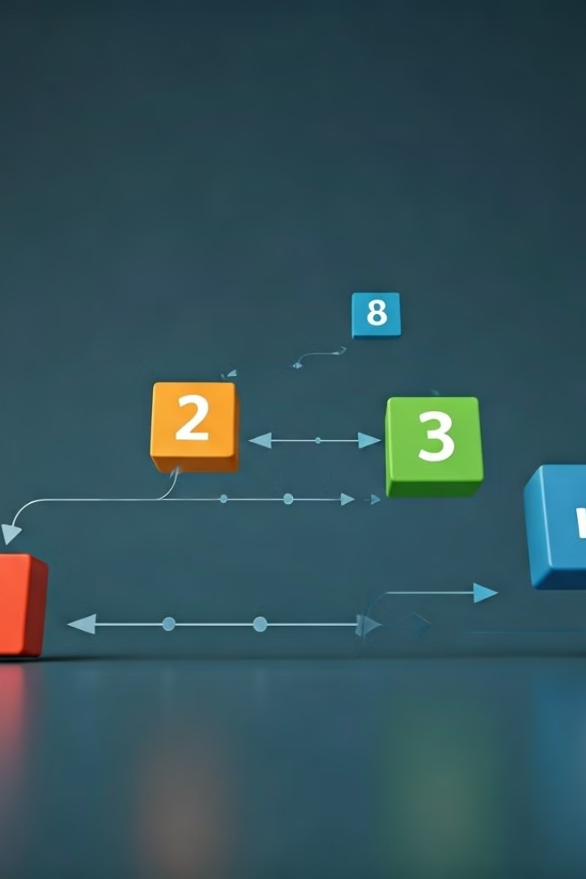
Create Project Timelines
1
Define Milestones
Key events or deliverables within a project, with their corresponding due dates.
2
Task Dependencies
Relationships between tasks, where the completion of one task depends on another.
3
Resource Allocation
Assign personnel or resources to specific tasks and milestones.
4
Duration Estimates
Assess the time required to complete each task and milestone.

Slide 4
Adjust Schedules
Progress Tracking
Dependency Updates
Resource Changes
Monitor actual progress against planned schedules.
Adjust schedules based on changes in task dependencies.
Modify schedules based on changes in available resources or personnel.

Slide 5

Object-Oriented Python Solution
Project Class
Timeline Class
Encapsulates project information, including timelines, tasks, and dependencies.
Represents a project timeline, with a collection of milestones and tasks.
Task Class
Milestone Class
Represents an individual task, including duration, dependencies, and resource allocation.
Represents a milestone, with a deadline and a set of associated tasks.

Slide 6




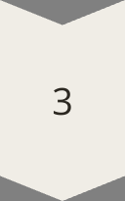
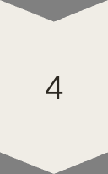
Manage Project Schedules
Schedule Creation
Users can create new project schedules, defining milestones, tasks, and dependencies.
Schedule Viewing
Users can view existing schedules, displaying timelines, task lists, and progress reports.
Schedule Updates
Users can update schedules by adjusting task durations, deadlines, or dependencies.
Schedule Reporting
The system generates reports summarizing progress, highlighting critical paths, and identifying potential issues.

Slide 7

Create, Read, Update, Delete
CRUD Operation
Description
Create
Add new schedule entries (projects, timelines, tasks, milestones)
Read
Retrieve schedule information for viewing or analysis
Update
Modify existing schedule entries based on project progress or changes
Delete
Remove outdated or unnecessary schedule entries

Slide 8


Address Problem Statement
The Project Scheduling Assistant POC addresses the need for a tool to effectively manage project schedules. By providing capabilities for creating, updating, and deleting schedules, the POC enables users to track progress, identify critical paths, and adapt to changing project dynamics.

Slide 9
Algorithm
Start
Initialize Project Scheduler
User selects action:
Create Timeline
Input: Timeline ID
Output: New ProjectTimeline created
Add Schedule
Input: Schedule Details
Output: Schedule added to ProjectTimeline
Adjust Schedule
Input: Schedule ID, New Dates
Output: Schedule adjusted based on dependencies
View Schedule
Input: Schedule ID
Output: Display schedule details
Delete Schedule
Input: Schedule ID
Output: Schedule removed
Repeat or End

Slide 10
FLOWCHART:
START
Create Timeline
Input: Timeline ID
Output: New ProjectTimeline created
Add Schedule
Input: Schedule Details
Output: Schedule added to ProjectTimeline
View Schedule
Input: Schedule ID
Output: Display schedule details
Adjust Schedule
Input: Schedule ID, New Dates
Output: Schedule adjusted based on dependencies
Delete Schedule
Input: Schedule ID
Output: Schedule removed
END

Slide 11
class Schedule:
def _init_(self, schedule_id, project_name, start_date, end_date):
self.schedule_id = schedule_id
self.project_name = project_name
self.start_date = start_date
self.end_date = end_date
def _repr_(self):
return f"Schedule(id={self.schedule_id}, project={self.project_name}, start={self.start_date}, end={self.end_date})“
class ProjectTimeline:
def _init_(self, timeline_id):
self.timeline_id = timeline_id
self.schedules = {}
def add_schedule(self, schedule):
if schedule.schedule_id in self.schedules:
raise ValueError(f"Schedule ID {schedule.schedule_id} already exists.") self.schedules[schedule.schedule_id] = schedule
def get_schedule(self, schedule_id):
return self.schedules.get(schedule_id, None)
def update_schedule(self, schedule_id, start_date=None, end_date=None):
schedule = self.get_schedule(schedule_id)

Slide 12
if not schedule:
raise ValueError("Schedule not found.")
if start_date:
schedule.start_date = start_date
if end_date:
schedule.end_date = end_date
def delete_schedule(self, schedule_id):
if schedule_id not in self.schedules:
raise ValueError("Schedule not found.")
del self.schedules[schedule_id]
def _repr_(self):
return f"ProjectTimeline(id={self.timeline_id}, schedules={self.schedules})“
class ProjectScheduler:
def _init_(self):
self.timelines = {}

Slide 13
def create_timeline(self, timeline_id):
if timeline_id in self.timelines:
raise ValueError(f"Timeline ID {timeline_id} already exists.") self.timelines[timeline_id] = ProjectTimeline(timeline_id)
def get_timeline(self, timeline_id):
return self.timelines.get(timeline_id, None)
def adjust_schedule(self, timeline_id, schedule_id, start_date=None, end_date=None):
timeline = self.get_timeline(timeline_id)
if not timeline:
raise ValueError("Timeline not found.") timeline.update_schedule(schedule_id, start_date, end_date)
def _repr_(self):
return f"ProjectScheduler(timelines={self.timelines})"

Slide 14
# Example usage
if __name__ == "__main__":
scheduler = ProjectScheduler()
# Create a project timeline
scheduler.create_timeline("timeline_1")
# Create a schedule and add it to the timeline
schedule1 = Schedule(schedule_id="schedule_1", project_name="Project A", start_date="2024-01-01", end_date="2024-01-31") scheduler.get_timeline("timeline_1").add_schedule(schedule1)
# Retrieve and print the timeline
print(scheduler.get_timeline("timeline_1"))
# Adjust the schedule
scheduler.adjust_schedule("timeline_1", "schedule_1", end_date="2024-02-15")

Slide 15
# Retrieve and print the updated timeline print(scheduler.get_timeline("timeline_1"))
# Delete the schedule scheduler.get_timeline("timeline_1").delete_schedule("schedule_1")
# Print the timeline after deletion
print(scheduler.get_timeline("timeline_1"))

Slide 16
OUTPUT:
ProjectScheduler(Timelines: [ProjectTimeline(ID: Timeline_1, Schedules: [Schedule(ID: Schedule_1, Name: Task 1, Start: 2024-09-01, End: 2024-09-05), Schedule(ID: Schedule_2, Name: Task 2, Start: 2024-09-06, End: 2024-09-10)])])
Adjusted Schedule: Schedule(ID: Schedule_1, Name: Task 1, Start: 2024-09-01, End: 2024-09-06)
Deleted Schedule: Schedule(ID: Schedule_2, Name: Task 2, Start: 2024-09-06, End: 2024-09-10)
ProjectScheduler(Timelines: [ProjectTimeline(ID: Timeline_1, Schedules: [Schedule(ID: Schedule_1, Name: Task 1, Start: 2024-09-01, End: 2024-09-06)])])

Slide 17
Thank you

